Slide 1
Improving Area and Resources
Vitis Unified IDE 2024.1
IQBAL
PhD Researcher
with Prof. Bruno

Slide 2
Objectives
After completing this module, you will be able to:
Describe how arbitrary precision data types can reduce resource utilization
List various area optimization techniques
List means by which resource utilization can be reduced

Slide 3
Optimizing Resource Utilization

Slide 4
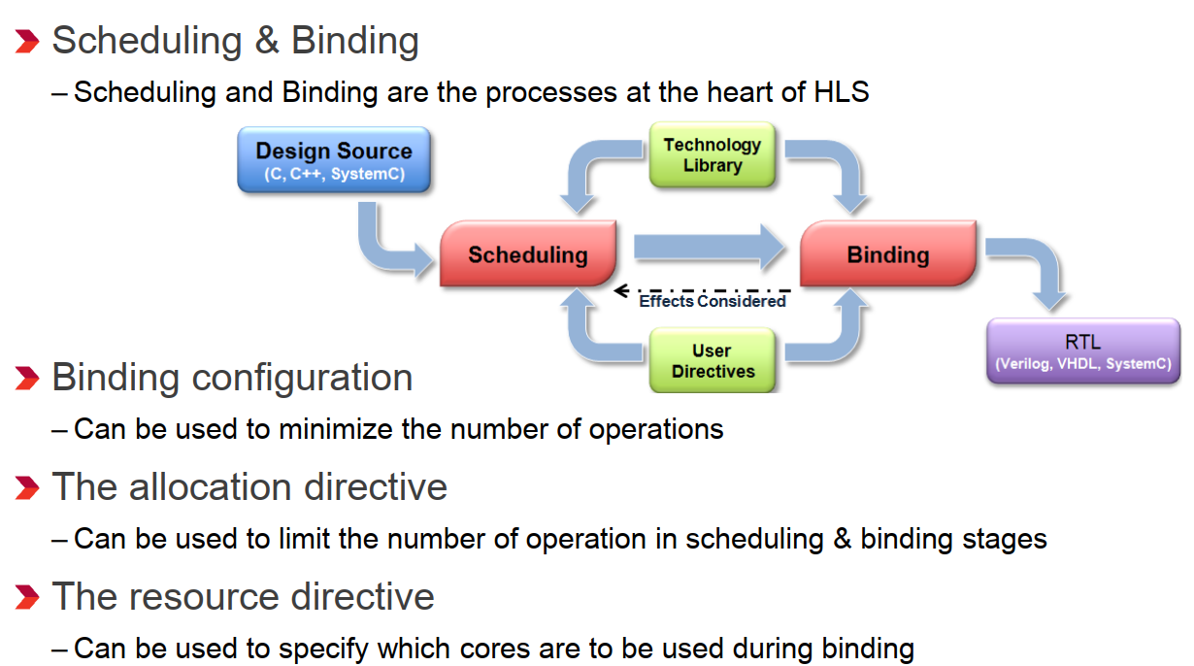
Review: Control Scheduling & Binding
: BIND_STORAGE and BIND_OP

Slide 5
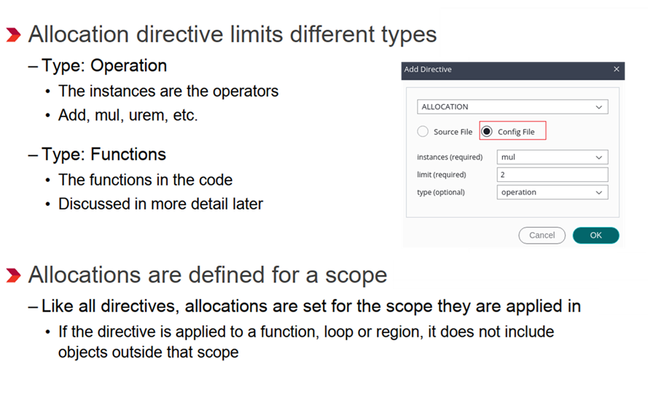
Allocation: Limit the Numbers

Slide 6
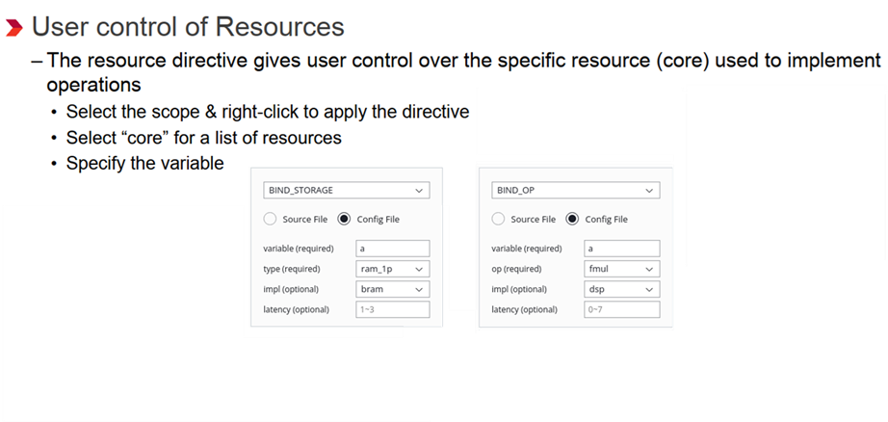
Additional Control: Specify Resources

Slide 7
Reducing Area Usage

Slide 8
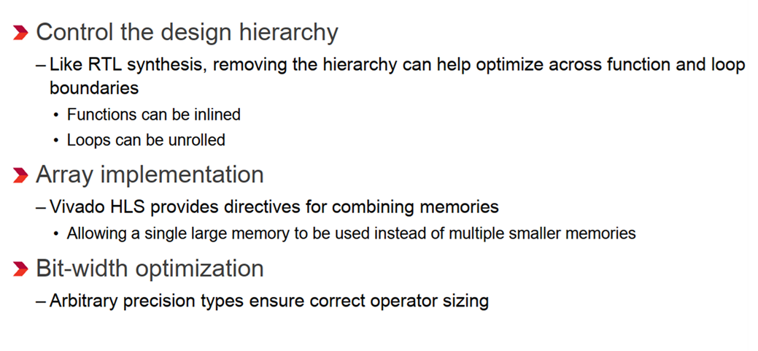
Improving Area

Slide 9
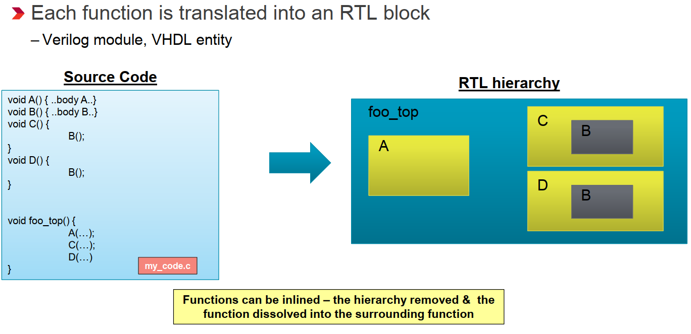
Review: Functions & RTL Hierarchy

Slide 10
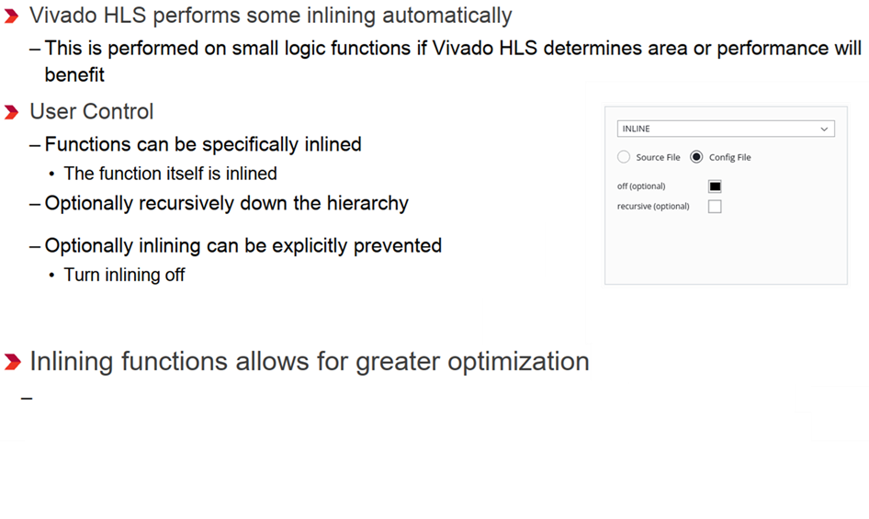
Controlling Inlining
Improve the area by allowing the components within the function to be better shared
or optimized with the logic in the calling function.

Slide 11
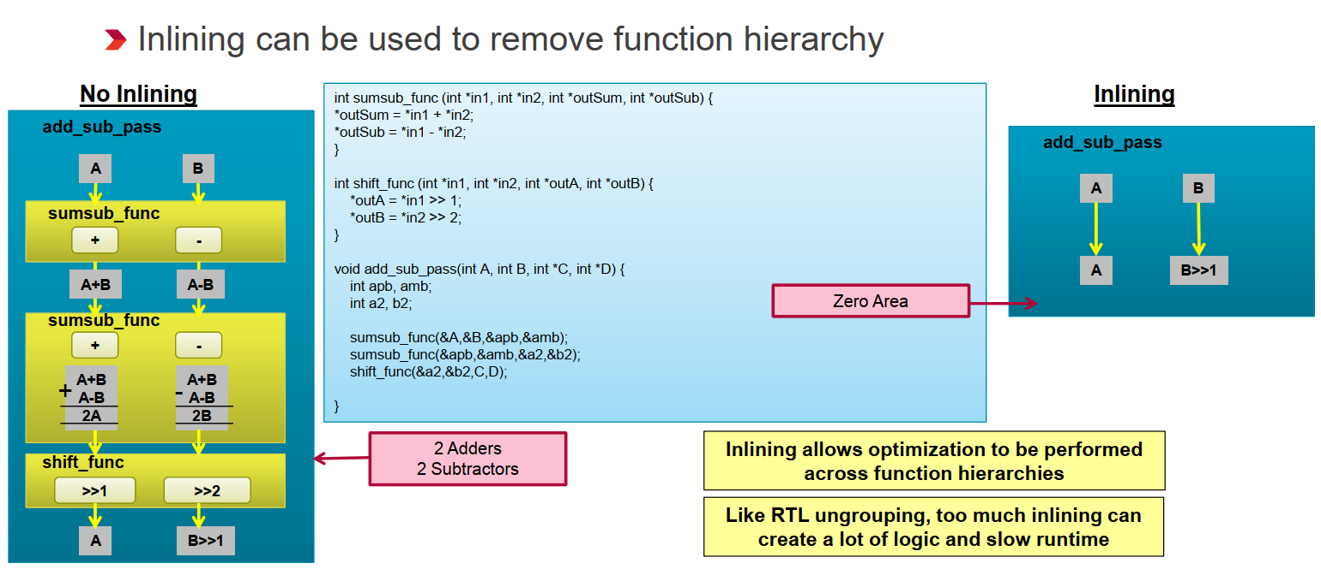
Function Inlining

Slide 12
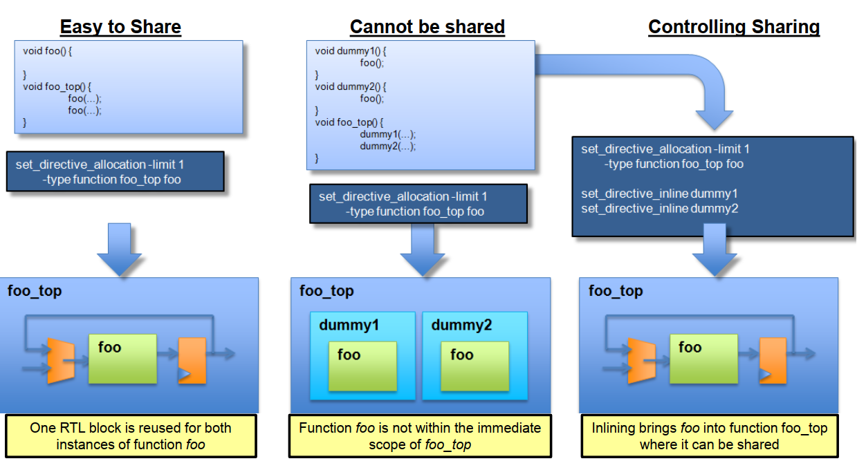
Inline and Allocation: Shape the Hierarchy

Slide 13
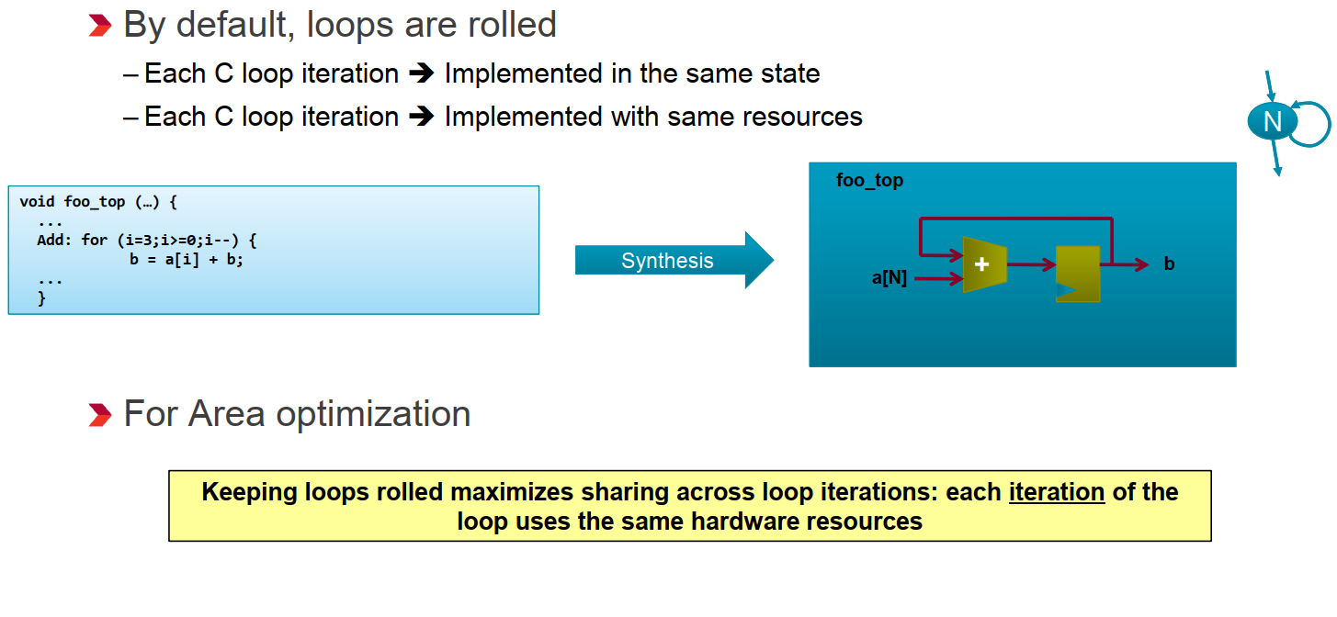
Loops

Slide 14
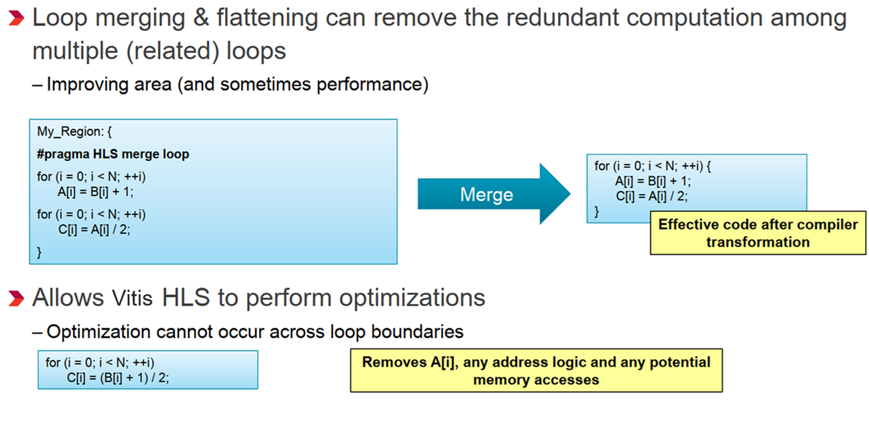
Loop Merging & Flattening

Slide 15
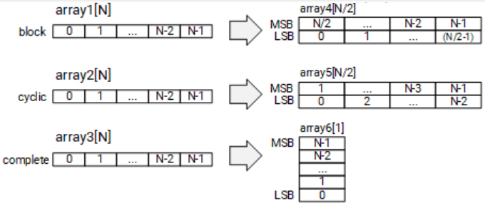
Array Reshaping
Reforms the array with a vertical mode of re-mapping
Reduce the number of block RAM consumed.
Provide parallel access to the data.

Slide 16
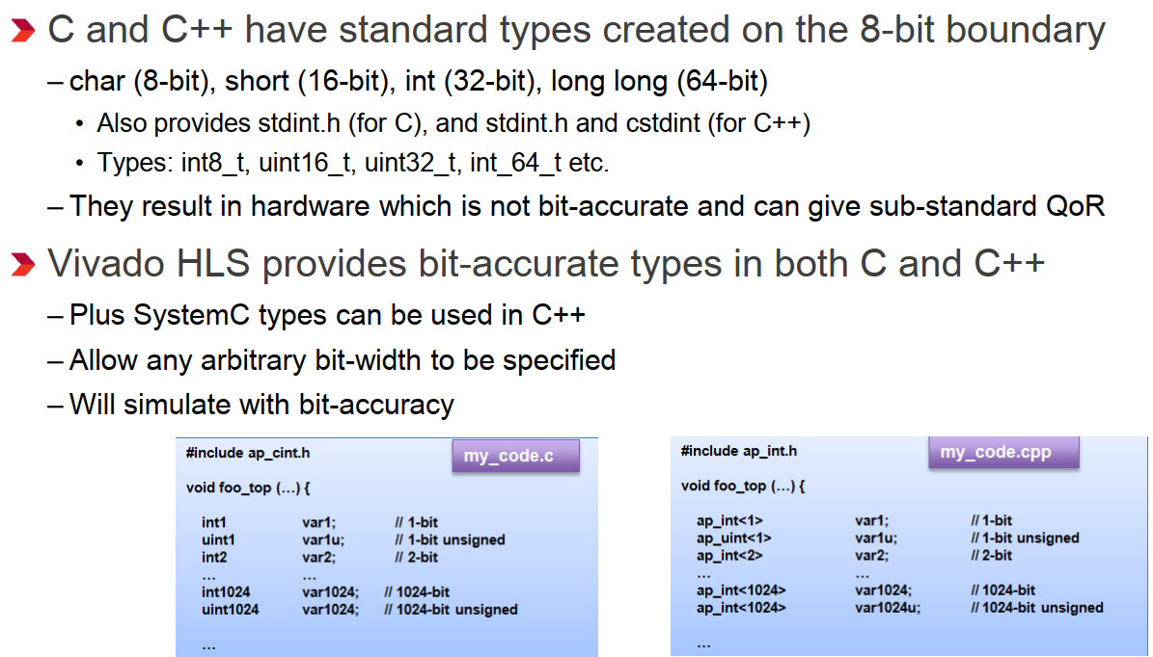
Arbitrary Precision Integers

Slide 17
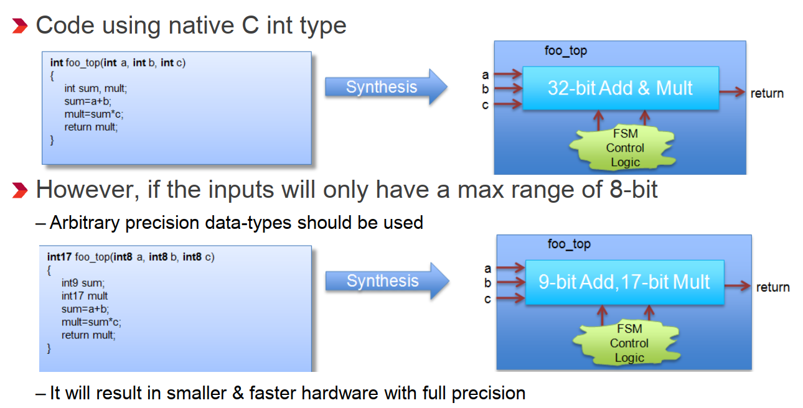
Why are Arbitrary Precision types Needed?

Slide 18
Lab-3
Performance vs Resource Utilization
Using DCT Design

Slide 19
Objectives
After completing this lab, you will be able to:
Add directives in your design
Understand the effect of PIPELINE directive
Understand the effect DATAFLOW directive on throughput
Using ALLOCATION to limit the resources consumption

Slide 20
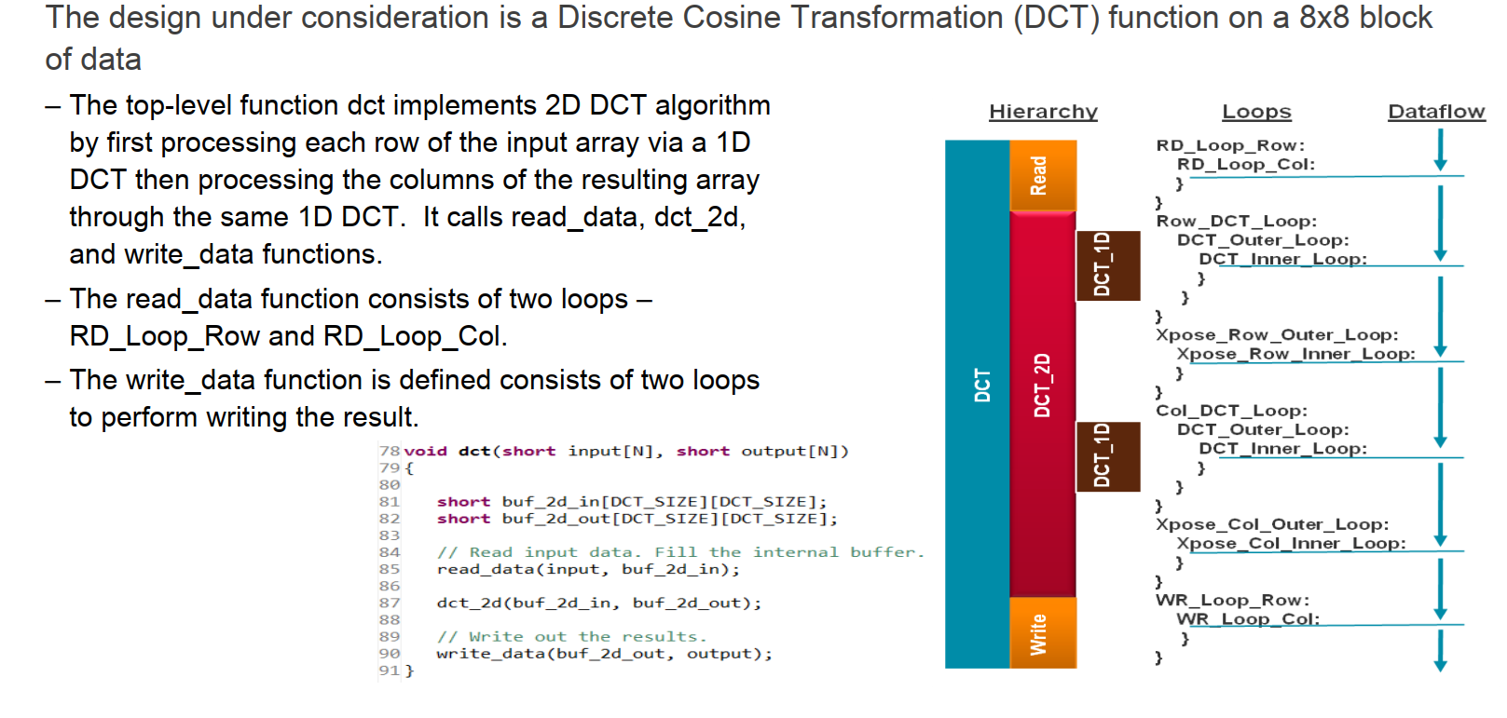
The Design

Slide 21
Task-3
Performance vs Resource Utilization
Image Processing Task

Slide 22
Procedure
Use the optimizations used in the lab 3 to reduce the area consumption of the function imGrayscale()

Slide 23
Thanks

